Slide 1



G H RAISONI COLLEGE OF ENGINEERING AND MANAGEMENT
(Approved by AICTE, New Delhi and Recognized by DTE, Maharashtra)
An Autonomous Institute Affiliated to Rashtrasant Tukadoji Maharaj Nagpur University, Nagpur
Accredited by NAAC with A+ Grade
Department of Electronics & Telecommunication Engineering
B. Tech Final Year - VII Sem.
Progressive Seminar
On
Visual Assistive System
Name of Projectees
Ashwini Sarode(05) Dewyani Date(12)
Ayurshi Moudekar (07) Mangesh Ghayal(25)
Devyani Belsare(11) Rishiket Deshmukh(40)
Guide:
Ms. Swati Hadke
Assistant Professor
Session 2025-2026
Nagpur | Pune | Jalgaon | Amravati | Pandhurna | Bhandara

Slide 2
Contents
Introduction
Literature Survey
Problem Statement
Objectives of the Project
Block Diagram
Components
Circuit Diagram
Feature Extraction
Mentor’s Suggestion
Innovative Work
Workdone (Till Date)
Expected Result
Survey
Project Cost Estimation
Work plan
References

Slide 3

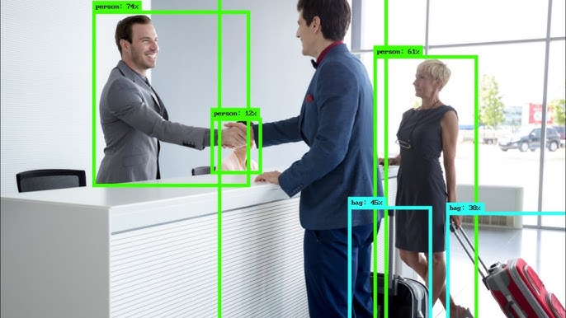
Introduction
Visual impairment is one of the major challenges that affects millions of people worldwide, limiting their independence and mobility in daily life.
A Visual Assistive System is designed to support visually impaired individuals by using modern technologies such as sensors, cameras, and microcontrollers to detect obstacles and provide feedback in the form of sound, vibration, or speech.
This system acts as a guiding tool, helping the user navigate safely in different environments and reducing their dependence on others.
By combining hardware and software, the Visual Assistive System improves accessibility, safety, and confidence, ultimately enhancing the quality of life for visually impaired individuals.

Slide 4
Literature Survey
Sr. No. | Paper Title and its Author | Details of Publication | Findings
1. | A Real-Time Object Detection System for Assistive Navigation for the Visually Impaired Author :- Abijith R. Nair & Sunitha S. Nair | Published in 2025 IJIREEICE publications (International Journal of Innovative Research in Electrical, Electronics, Instrumentation and Control Engineering) | Developed a real-time object detection system for assistive navigation, addressing dataset diversity, low-power model optimization, and multimodal feedback for fast, practical deployment.
2. | Small Object Detection for Indoor Assistance to the Blind using YOLO NAS Small and Super Gradients Author:-Rashmi BN, R. Guru, Anusuya MA | Published in 2024 arXiv preprint (submitted 28 August 2024) | Used YOLO NAS Small with Super Gradients to achieve real-time, accurate indoor object detection for low-latency voice guidance.

Slide 5
Literature Survey
Sr. No. | Paper Title and its Author | Details of Publication | Findings
3. | Implementing Visual Assistant using YOLO and SSD for Visually-Impaired Persons Author:-Ratnesh Litoriya, Kailash Chandra Bandhu, Sanket Gupta, Ishika Rajawat, Hany Jagwani, Chirayu Yadav | Published in 2024 Journal of Automation, Mobile Robotics and Intelligent Systems | Developed a low-cost real-time object detection system on Raspberry Pi 3 using YOLO and OpenCV, providing accurate recognition and audio feedback for visually impaired navigation.
4. | YOLO-OD: Obstacle Detection for Visually Author:-Impaired Navigation Assistance Unnamed authors at Changchun University, China | Published in 2024 Sensors journal | Proposed an obstacle detection model named YOLO-OD, introducing a Feature Weighting

Slide 6
Literature Survey
Sr. No. | Paper Title and its Author | Details of Publication | Findings
5. | Smart Assistive System for Visually Impaired People Obstruction Avoidance Through Object Detection and Classification Author :- Usman masud, Tareq saeed, Hunida m. Malaikah, Fezan ul Islam and Ghulam Abbas. | Published in 2022 IEEE | The system is low-cost, portable, offline, efficient (91% accuracy), and designed with Raspberry Pi + Arduino, ultrasonic sensors, and camera, combining classical (Viola–Jones) and modern (TensorFlow) object detection for assisting visually impaired users.

Slide 7
Problem Statement
Visually impaired individuals face difficulties in identifying and recognizing objects in their immediate surroundings.
Lack of awareness about nearby objects often leads to mobility challenges and safety risks.
Existing assistive tools are either expensive, limited in functionality, or not real-time.
There is a strong need for a low-cost, real-time object detection system with audio feedback to support independence and daily activities for blind users.

Slide 8
Objectives of the Project
Develop a real-time object detection system using YOLOv11 trained on the COCO dataset to recognize 80+ common objects.
Integrate Text-to-Speech (TTS) to convert detected object names into clear audio output for blind users.
Ensure low-cost and portable implementation using Python and accessible hardware (e.g., webcam, Raspberry Pi, laptop).
Enhance mobility, safety, and independence of visually impaired individuals by providing instant audio awareness of their surroundings.

Slide 9
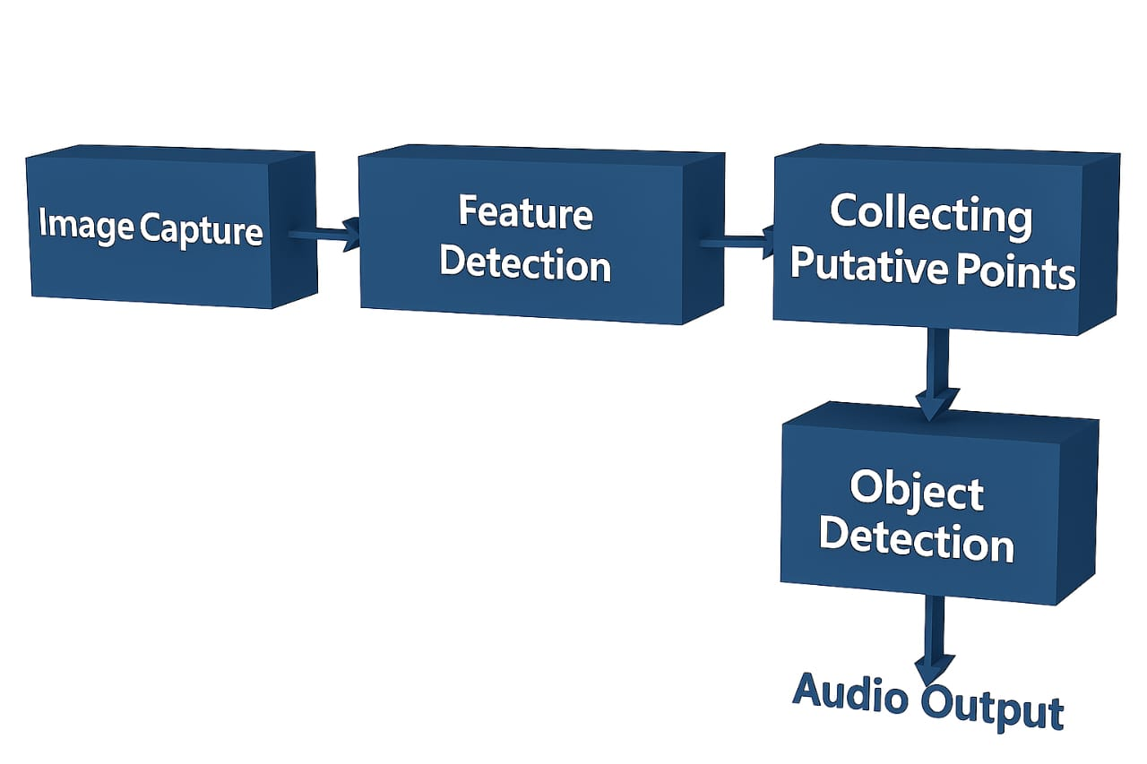
Block Diagram

Slide 10
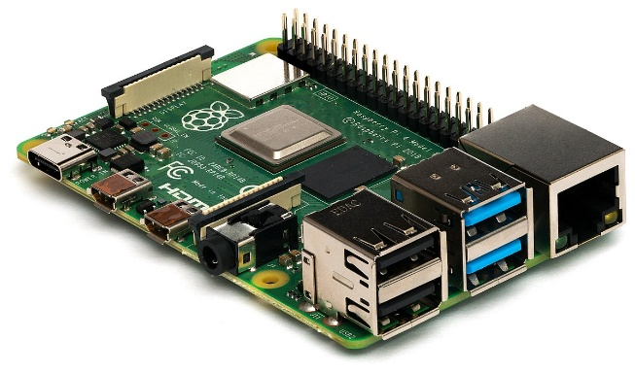
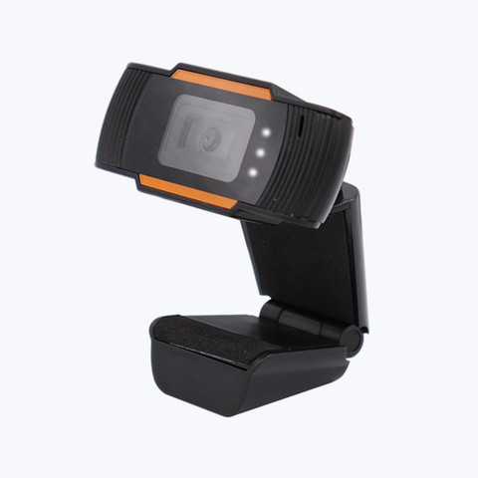
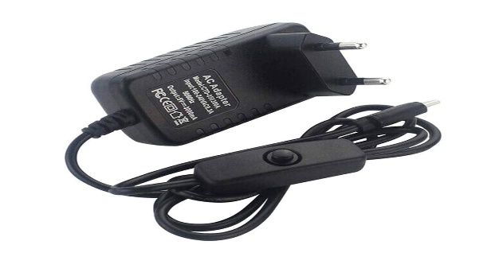
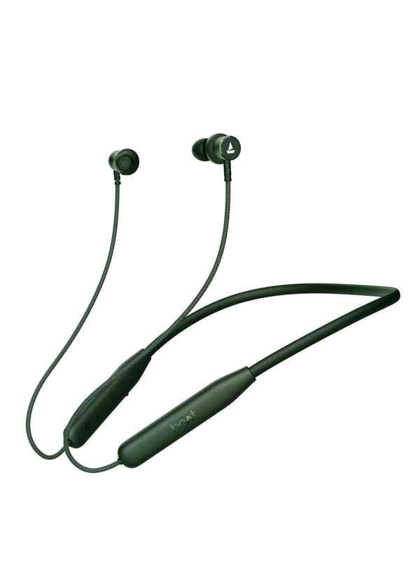
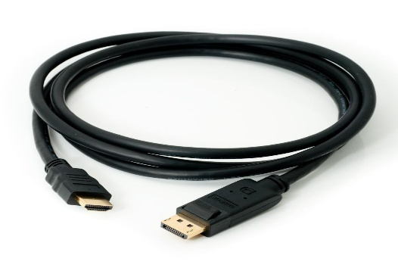
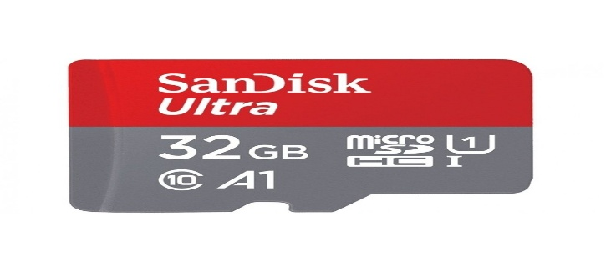
Components
Raspberry Pi 4 model B
64-bit Soc 1.5GHz
40 GPIO pins
Speed 1.5 GHz
Zebronics Web 720p Camera(with Night vision)
Built in mic feature
Power Adaptor (C Type )
5 Volts
3 Amp
Scan Disk Card
Used for Storage
32 GB
HDMI Cable
Bluetooth Earphone

Slide 11
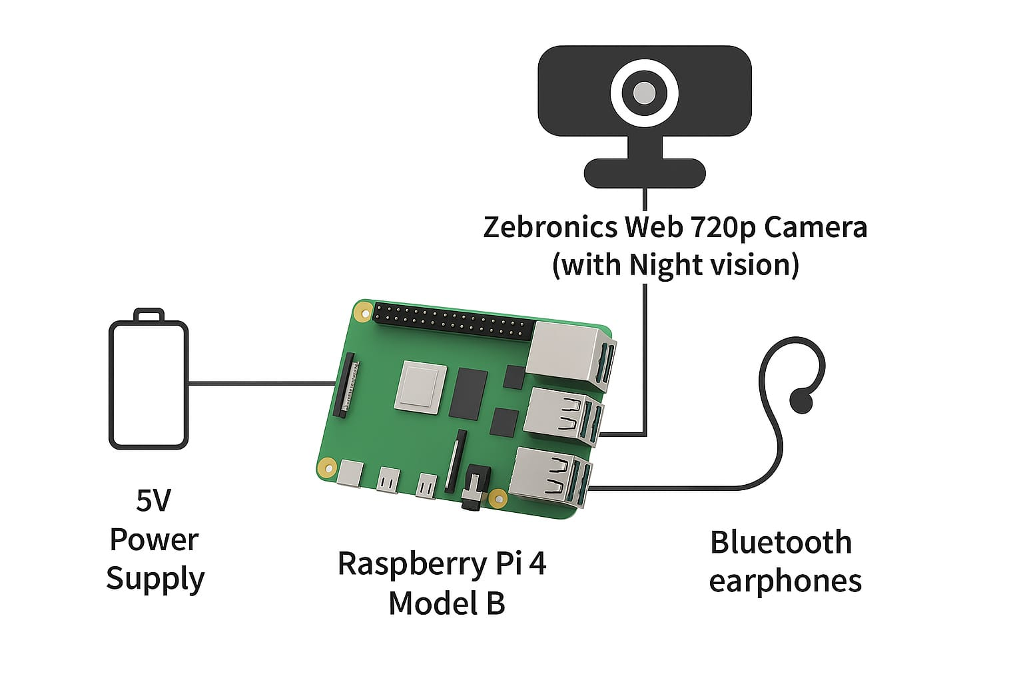
Circuit Diagram

Slide 12
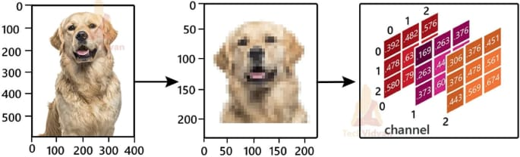
Feature Extraction

Slide 13
Mentor’s Suggestions
Optimize Object Detection Algorithm:-Improve accuracy by using a pre-trained model like YOLO or SSD for faster and more reliable object detection.
Expand Data Sheet Gradually:-Start testing with the current set of 80 objects, and gradually expand the dataset as the system becomes stable.
Our mentor suggested us to conduct a survey in order to understand the real needs and challenges faced by visually impaired people at “Mundle Blind School”, Nagpur.

Slide 14
Innovative Work
Innovative Work – YOLO-11 Text to Audio for Blind Assistance
Real-time YOLO-11 detection to localize text in natural scenes with high accuracy.
Intelligent filtering – avoids repeating the same text, ensuring smooth and useful narration.
Text-to-Speech conversion to provide instant audio feedback for visually impaired users.
Portable & low-cost solution deployable on edge devices for accessibility anywhere.
Assistive technology impact – bridging the information gap for blind users in daily life.

Slide 15
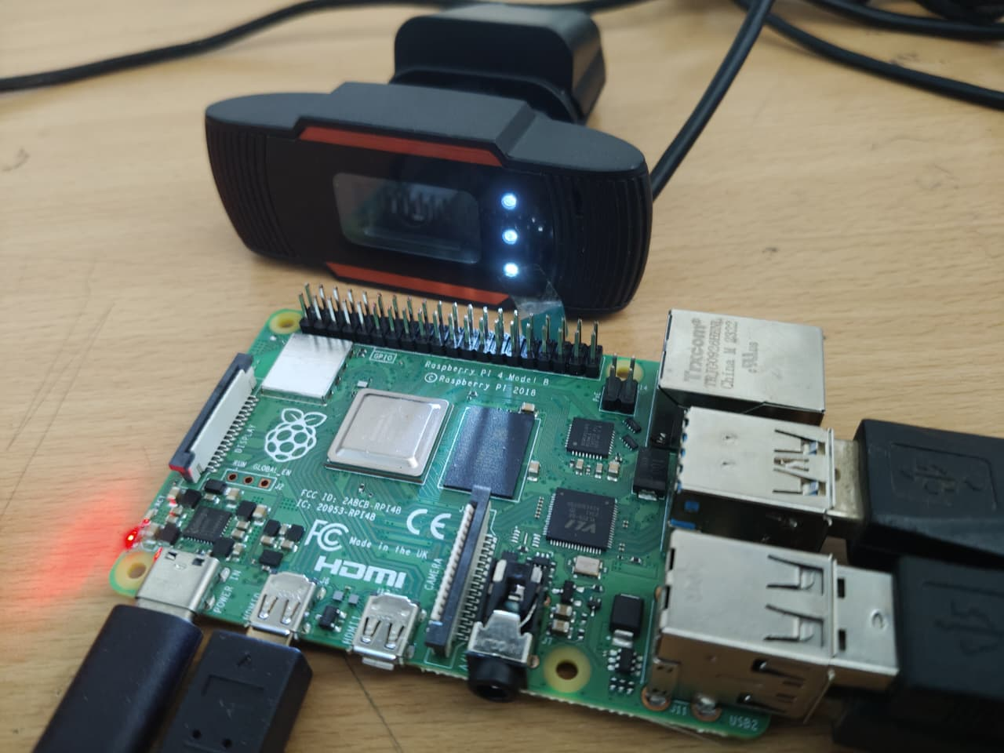
Workdone (Till date)
Audio Feedback Implementation:-
Successfully implemented the Audio Feedback Module using Text-to-Speech (TTS) technology.The system provides clear and understandable voice instructions to alert the user about detected objects and obstacles in real-time.
Object Data Sheet Preparation:-
Prepared a Data Sheet of 80 Common Objects(e.g., chair, table, door, staircase, bottle, etc.).This data sheet contains images and labeled data for training and reference in the object detection model.
System Integration (In Progress):-
The system hardware (camera, microcontroller, output module) has been assembled and basic connectivity is done.

Slide 16
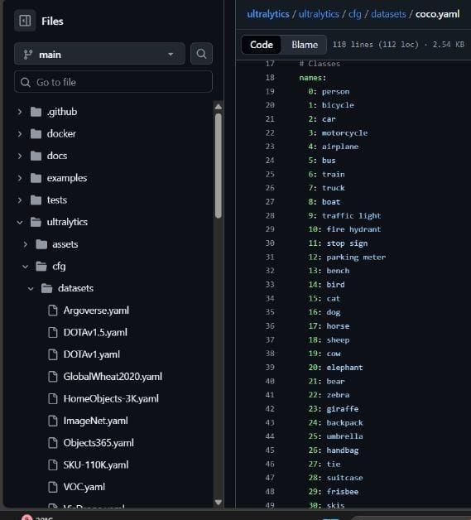
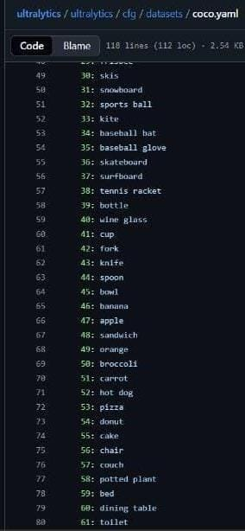
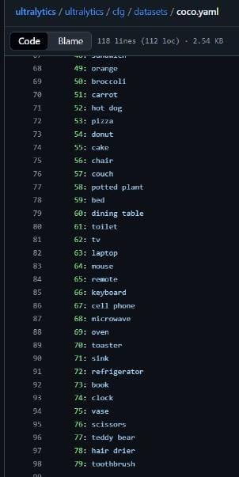
Workdone (Till date)

Slide 17
Expected Result
The system will successfully detect obstacles within the predefined range (e.g., 2 cm – 400 cm)
Raspberry Pi will process the sensor data in real time and provide audio or vibration alerts to the blind person.
The device will allow safe navigation both indoors and outdoors, reducing the risk of collisions.
The system will be portable, low-cost, and user-friendly, compared to commercial alternatives.
The overall accuracy of obstacle detection will be high enough to ensure user safety and confidence.
Future extensions like GPS navigation and AI-based object recognition can further enhance the system.

Slide 18
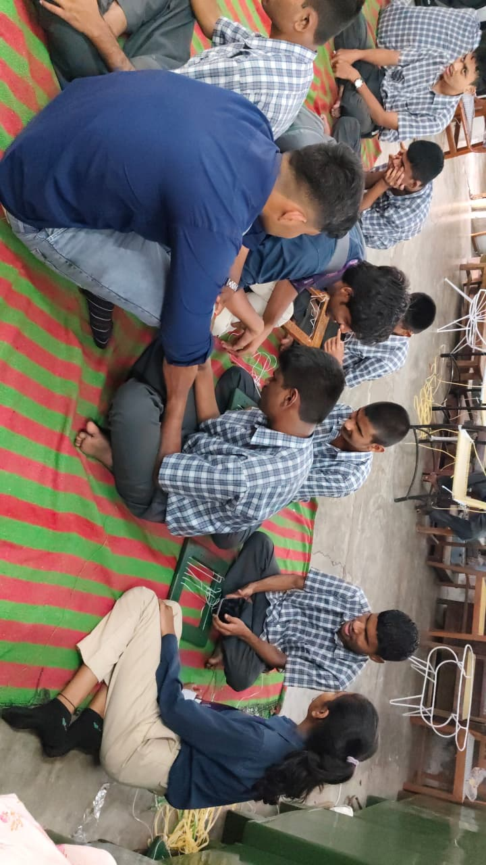
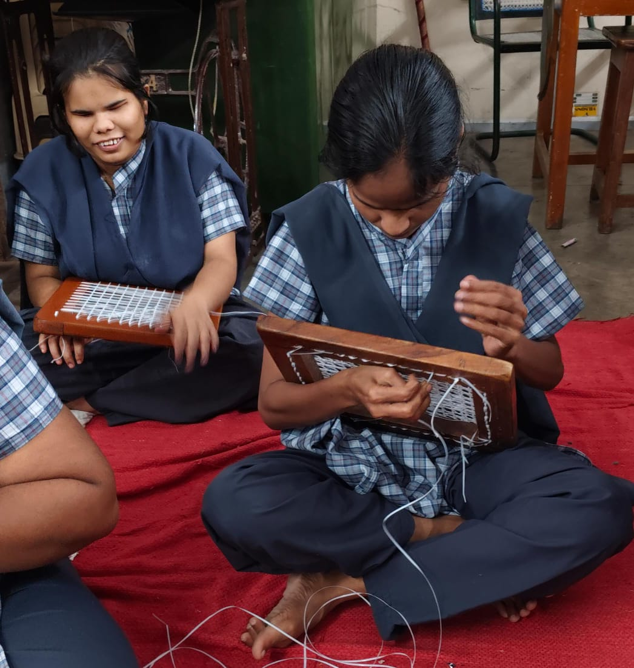
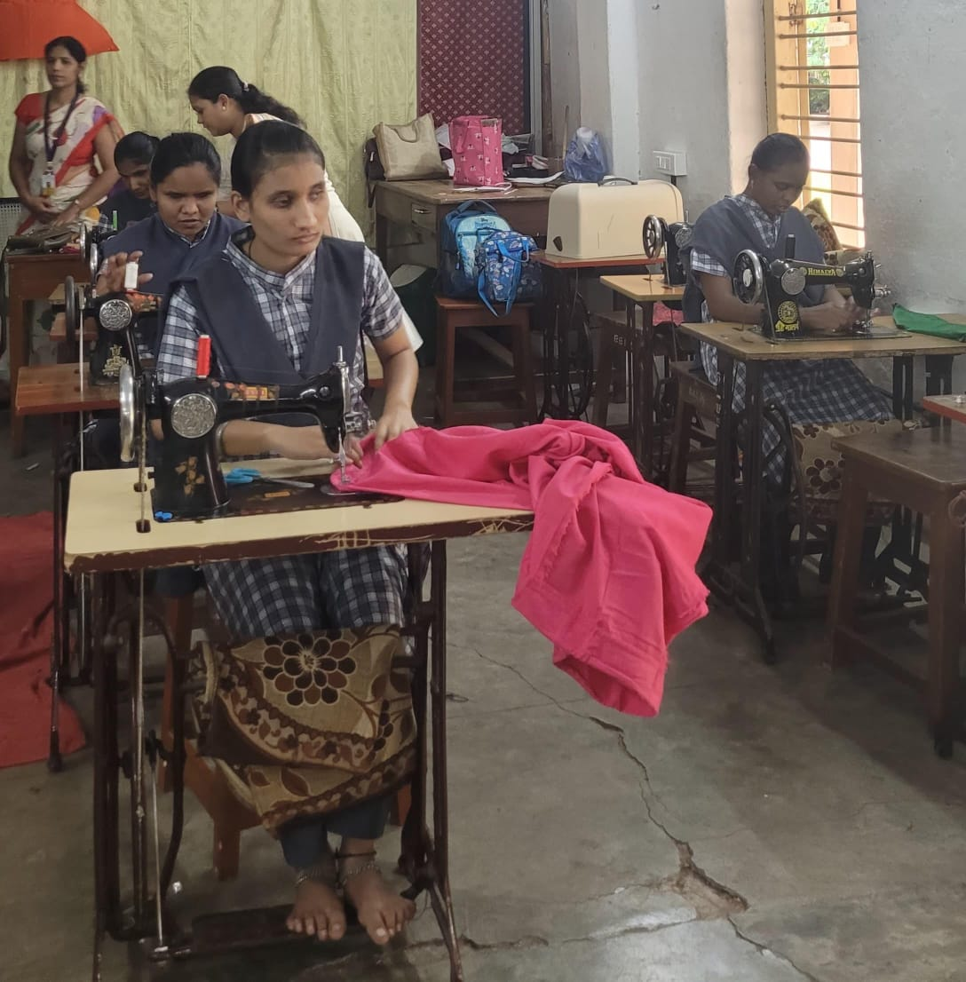
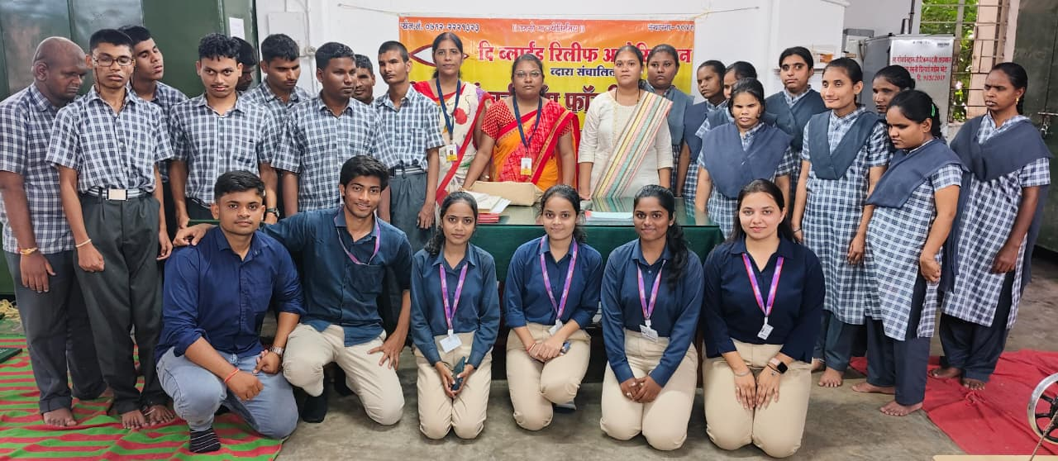
Survey at “ Mundle Blind School, Nagpur ”

Slide 19
Project Cost Estimation
Sr. No. | Items | Quantity | Amount In (Rs.)
1 | Raspberry Pi 4 Model B | 1 | 7,000/-
2 | Power Adaptor | 1 | 350/-
3 | HDMI Cable | 1 | 400/-
4 | Web Camera | 1 | 2,500/-
5 | Bluetooth Earphone | 1 | 1,200/-
6 | Scan Disk Card | 1 | 550/-
Total Amount (Rs.) |  |  | 12,000/-

Slide 20
Work – Plan
Months Activities | JUN’24 | JULY’24 | AUG’24 | SEPT’24 | OCT’24
Literature Reviews | √ | √ | √ | √
Component Identification & Selection |  | √ | √
Designing |  |  | √ | √
Fabrication |  |  | √ | √
Experimental Analysis |  |  | √ | √
Testing and Debugging |  |  | √ | √
Preparation of Project Report |  |  | √ | √
Thesis and Poster Submission |  |  |  | √ | √

Slide 21
References
Litoriya, Kailash Chandra Bandhu, Sanket Gupta, Ishika Rajawat, Hany Jagwani, Chirayu Yadav. Implementing Visual Assistant using YOLO and SSD for Visually-Impaired Persons. Journal of Automation, Mobile Robotics and Intelligent Systems, Vol. 17, Issue 4/2023, pp. 79–87, 2024. DOI:10.14313/JAMRIS/42023/33
Changchun University Researchers. YOLO‑OD: Obstacle Detection for Visually Impaired Navigation Assistance. Sensors, Vol. 24(23), Article no. 7621, 2024. DOI: 10.3390/s24237621
Rashmi BN, R. Guru, Anusuya MA. Small Object Detection for Indoor Assistance to the Blind using YOLO NAS Small and Super Gradients. arXiv preprint, 2024. arXiv:2409.07469
Pramod Kumar Sagar, Anant Mishra, Akhilendra Mishra. Object Detection for Blind Person. International Journal of Modern Developments in Engineering and Science (IJMDES), Vol. 4, No. 5, pp. 15–18, 2025. Link
Abijith R. Nair & Sunitha S. Nair. A Real‑Time Object Detection System for Assistive Navigation in the Visually Impaired. International Journal of Innovative Research in Electrical, Electronics, Instrumentation and Control Engineering (IJIREEICE), 2025. DOI: 10.17148/IJIREEICE.2025.13807
.

Slide 22
Thank you !
Nagpur | Pune | Jalgaon | Amravati | Pandhurna | Bhandara

